Slide 1


Key points
1. Acute traumatic cervical spinal cord injury
2. Neutrophil-to-lymphocyte ratio
3. Prognostic value of 6-month outcome

Slide 2
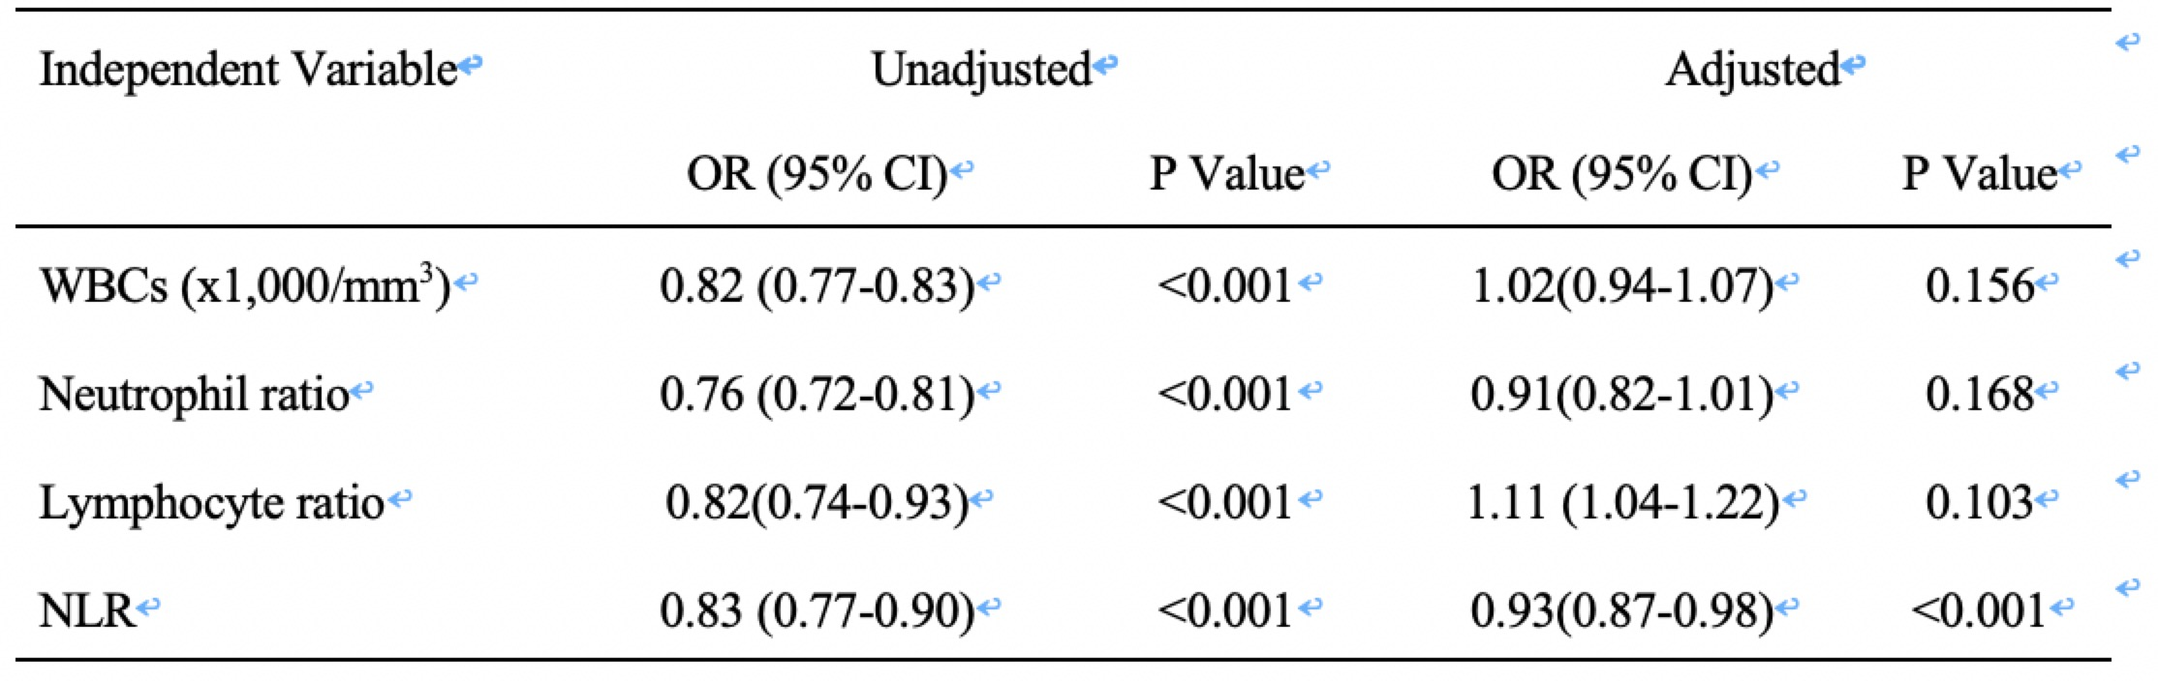
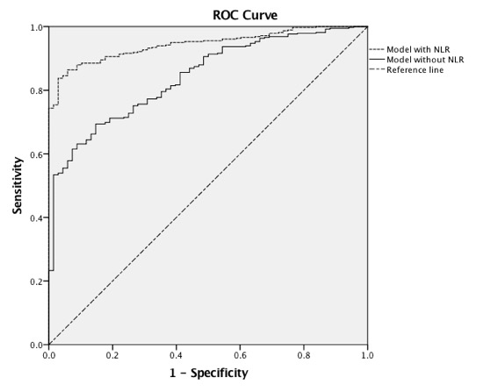
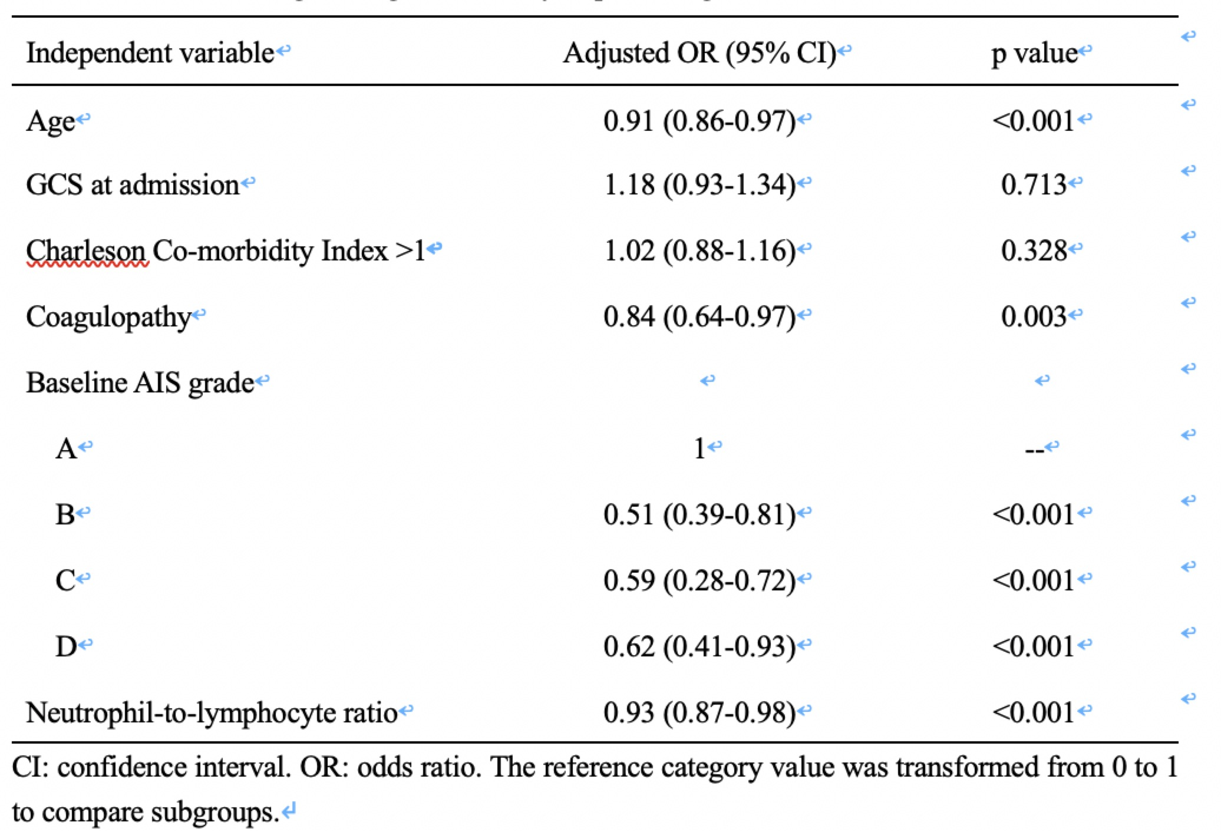
Associations of Leukocyte Counts and Neutrophil-to-Lymphocyte Ratio (NLR) with the 6-months outcome of tSCI patients
Multivariate logistic regression analysis predicting the 6-months outcome

Slide 3
Take Home Messages
1. The first study specifically designed to evaluate the prognostic value of neutrophil-to-lymphocyte ratio (NLR) with respect to the 6-month outcome in patients with acute cervical traumatic spinal cord injury
2. NLR is an independent predictor of the 6-month outcome in acute cervical tSCI patients, and its prognostic value is favorable.
3. A high NLR is associated with poor outcome in patients with acute cervical tSCI.

